Slide 1
One error in data mapping
can cause
ripples in the organization
Adequate data mapping is the preemptive solution to a potentially damaging problem.
Data mapping is an essential component of data processes. One error in data mapping can cause ripples in the organization, bringing it to ruins through replicated errors and inaccurate analysis. So, if you fail to understand the significance of data mapping or how it’s implemented, you are minimizing the chances of your business becoming a success.
https://dzone.com/articles/what-is-data-mapping
https://dzone.com/articles/know-how-data-mapping-supports-data-transformation

Slide 2
Patient Data Transformation Process from Infopad to SupportPrim
5
Baseline
6
Case
JSON
JSON
Infopad
Patient Data as
Key-Value Pair
Norwegian to English
1
Patient Data Structure
SupportPrim
XML
2
3
XML
&
JSON
JSON
3rd Month
4
JSON
JSON
This patient data structure (json) will be used as standard representation for patient data exchange and interoperability.
Flat xml and json data format derived from Infopad. This will serve as the patient data for further transformations.
Treatment
Converting Norwegian to English json
JSON
The Infopad patient data is in form xml format. It is meant for UI of Infopad, thus not structured for data exchange.
These transformation can be possible as per the requirements.

Slide 3
Transformation Challenges
Format transformation (xml to json)
Schemas (xml and json) https://jsonschema.net/home
Structural transformation (xml to xml OR json to json)
Value representation
Attribute representation
List representation
Complex representation
Creation of new entities
Name and Value mapping (variable name and its value consistency)
Language transformation of values (need to be consistent)
Datatype (range, constraints, exceptions)
Semantic mapping
Variable description or additional information
Need to keep master templates that are invariant for intermediate variation of element values.
Keeping the code / system invariant for the points 1, 2, …, 8.
Conformance validation
Interoperability for UI, CBR, ISM , elastic search, analytics, etc.
Computer interpretable
Human interpretable/readable
Interpretability, readability, and ease of maintenance and knowledge transfer

Slide 4
XML to JSON
XML element or attribute names become JSON object names
XML children elements become JSON objects fields or arrays
XML text nodes become JSON simple values
{
"people": {
"person": [
{
"age": "40",
"name": "John Smith"
},
{
"age": "43",
"name": "Jane Foster"
}
]
}
}
<people>
<person>
<name>John Smith</name>
<age>40</age>
</person>
<person>
<name>Jane Foster</name>
<age>43</age>
</person>
</people>

Slide 5
XML to JSON
Preserve XML notion of attributes
{
"title": {
"@isbn": "15115115",
"text()": "This book is on XML and JSON"
}
}
<title isbn="15115115">This book is on XML and JSON</title>
An XML element could contain both child elements and text
{
"name": {
"br": {},
"text()": "JohnSmith"
}
}
<name>John<br/>Smith</name>

Slide 6
Patient Data Transformation Process from Infopad to SupportPrim
Preserve document order with JSON array
{
"name": [
"br": {},
"text()": "JohnSmith"
]
}
<name>John<br/>Smith</name>
JSON does not support a name-scoping mechanism
{ "foo": {
"root": {
"bar": {
"@att": "1"
},
"foo": {
"node": {}
}
}
}
}
<n:root xmlns:n=\"foo\" xmlns:l=\"bar\" l:att=\"1\">
<n:node/>
</n:root>

Slide 7
Patient Data Transformation Process from Infopad to SupportPrim
May be necessary to keep track of the original XML type annotation
{
“year” : {
"xsi:type" : "xs:positiveInteger",
value : 1989
}
}
<year xsi:type="xs:positiveInteger">1989</year>

Slide 8
JSON transformers
JSON transformation with Liquid
JSON transformation with JOLT
JSON transformation with NIFI

Slide 9
Transformations
Source
xml
Transformer
xslt
Helper
xml
Helper
json
Helper
json
Master Templates
json
Target
json

Slide 10
Forward-Backward Mapping (json)
Source Data
Variable Template
Value Template
Standard Data
Source key | Source value
sk1 | sv1
sk2 | sv2
sk3 | sv3
Mapping key | Source key
mk1 | sk1
mk2 | sk2
mk3 | sk3
Source value | Mapping value
sv1 | mv1
sv2 | mv2
sv3 | mv3
Mapping key | Mapping value
mk1 | mv1
mk2 | mv2
mk3 | mv3
1
2
3
4

Slide 11
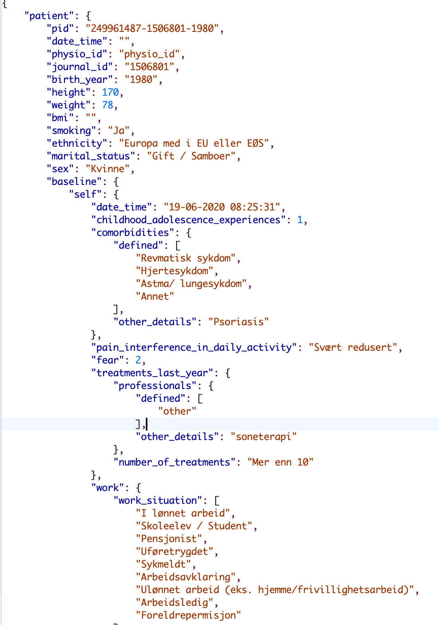
All the highlighted values have been encoded thus they could be replaced with their codes.
Also, most of the SupportPrim variable values are ordinal scales or fixed set of nominal values

Slide 12
https://identitydocs.akamai.com/home/data-mapping-and-transformation
https://docs.agilite.io/docs/json-to-json-data-mapping-profile
I have good news for you. There is indeed an open source program that will accomplish this for you. Talend Open Studio (TOS) ESB (not to be confused with their TOS for Data Integration). Any ESB tool should do this quite easily. See below:
https://stackoverflow.com/questions/41473628/json-to-json-mapper

